Slide 1

Library Management System
Bhargava Manikanta Aditya Tummalapenta (1001965491)
Lakshmi Radha Yashwanth Uppuganti (1001964009)

Slide 2
Why our application?
Simple Workflow
No long queue lines
Immediate book issuing / buying
Ease of Use

Slide 3
Technologies:
Google App Engine
Google Cloud SQL
Git
Google Developer Cheat Sheet
Other technologies include :
ReactJS
PHP

Slide 4
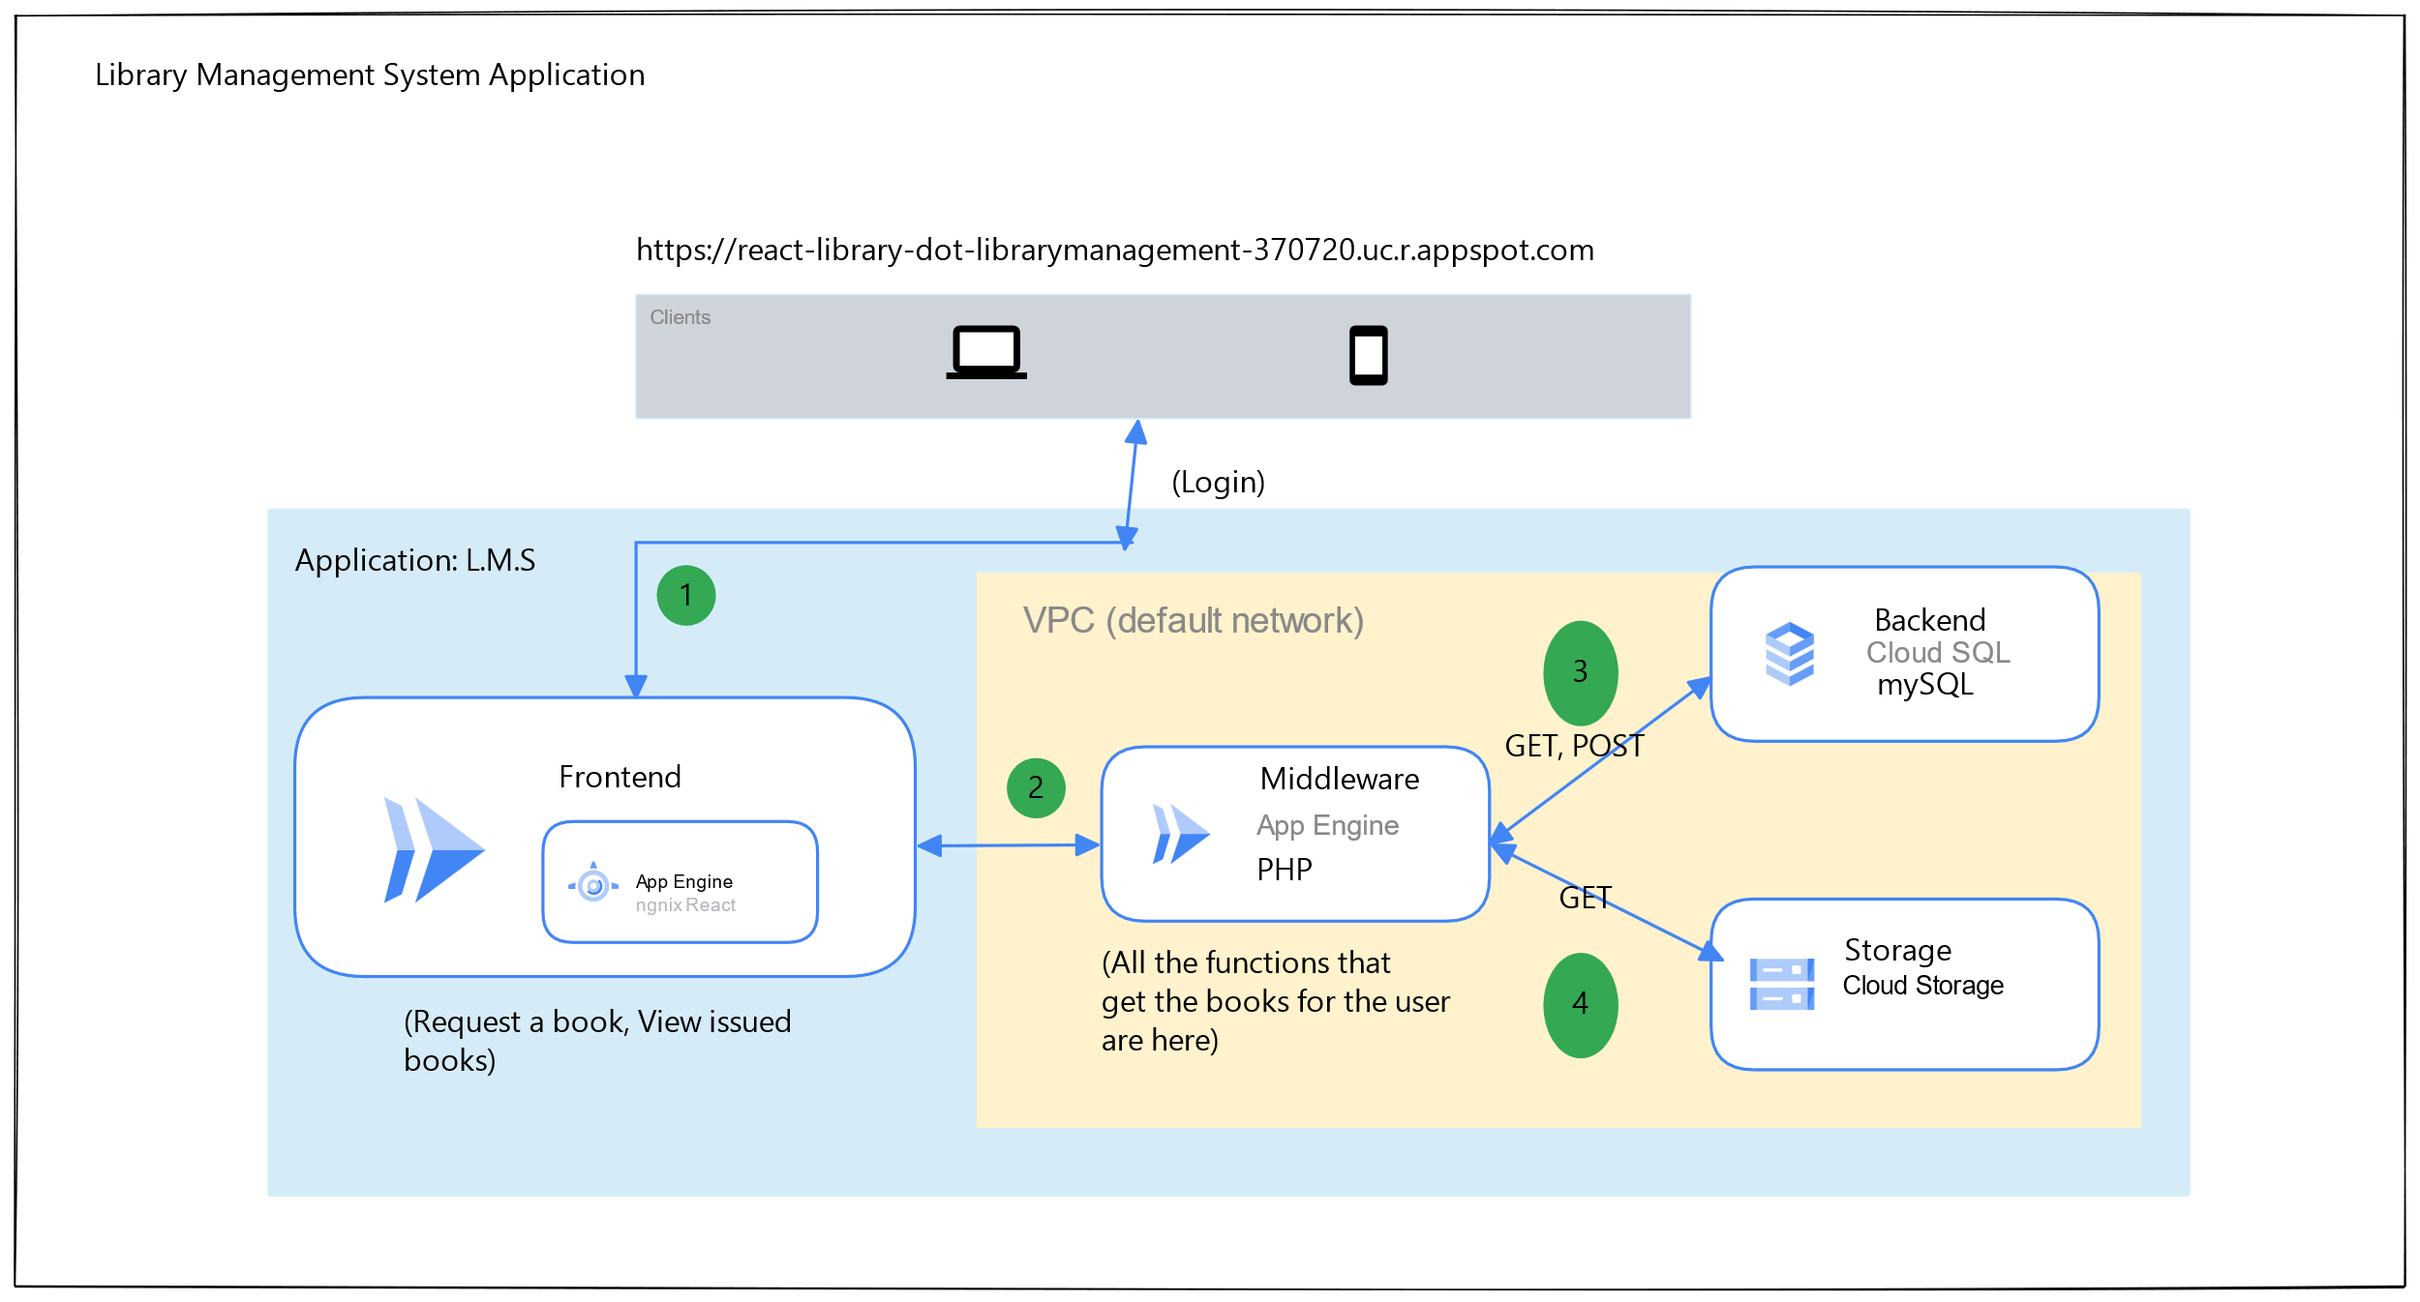
Architecture:

Slide 5
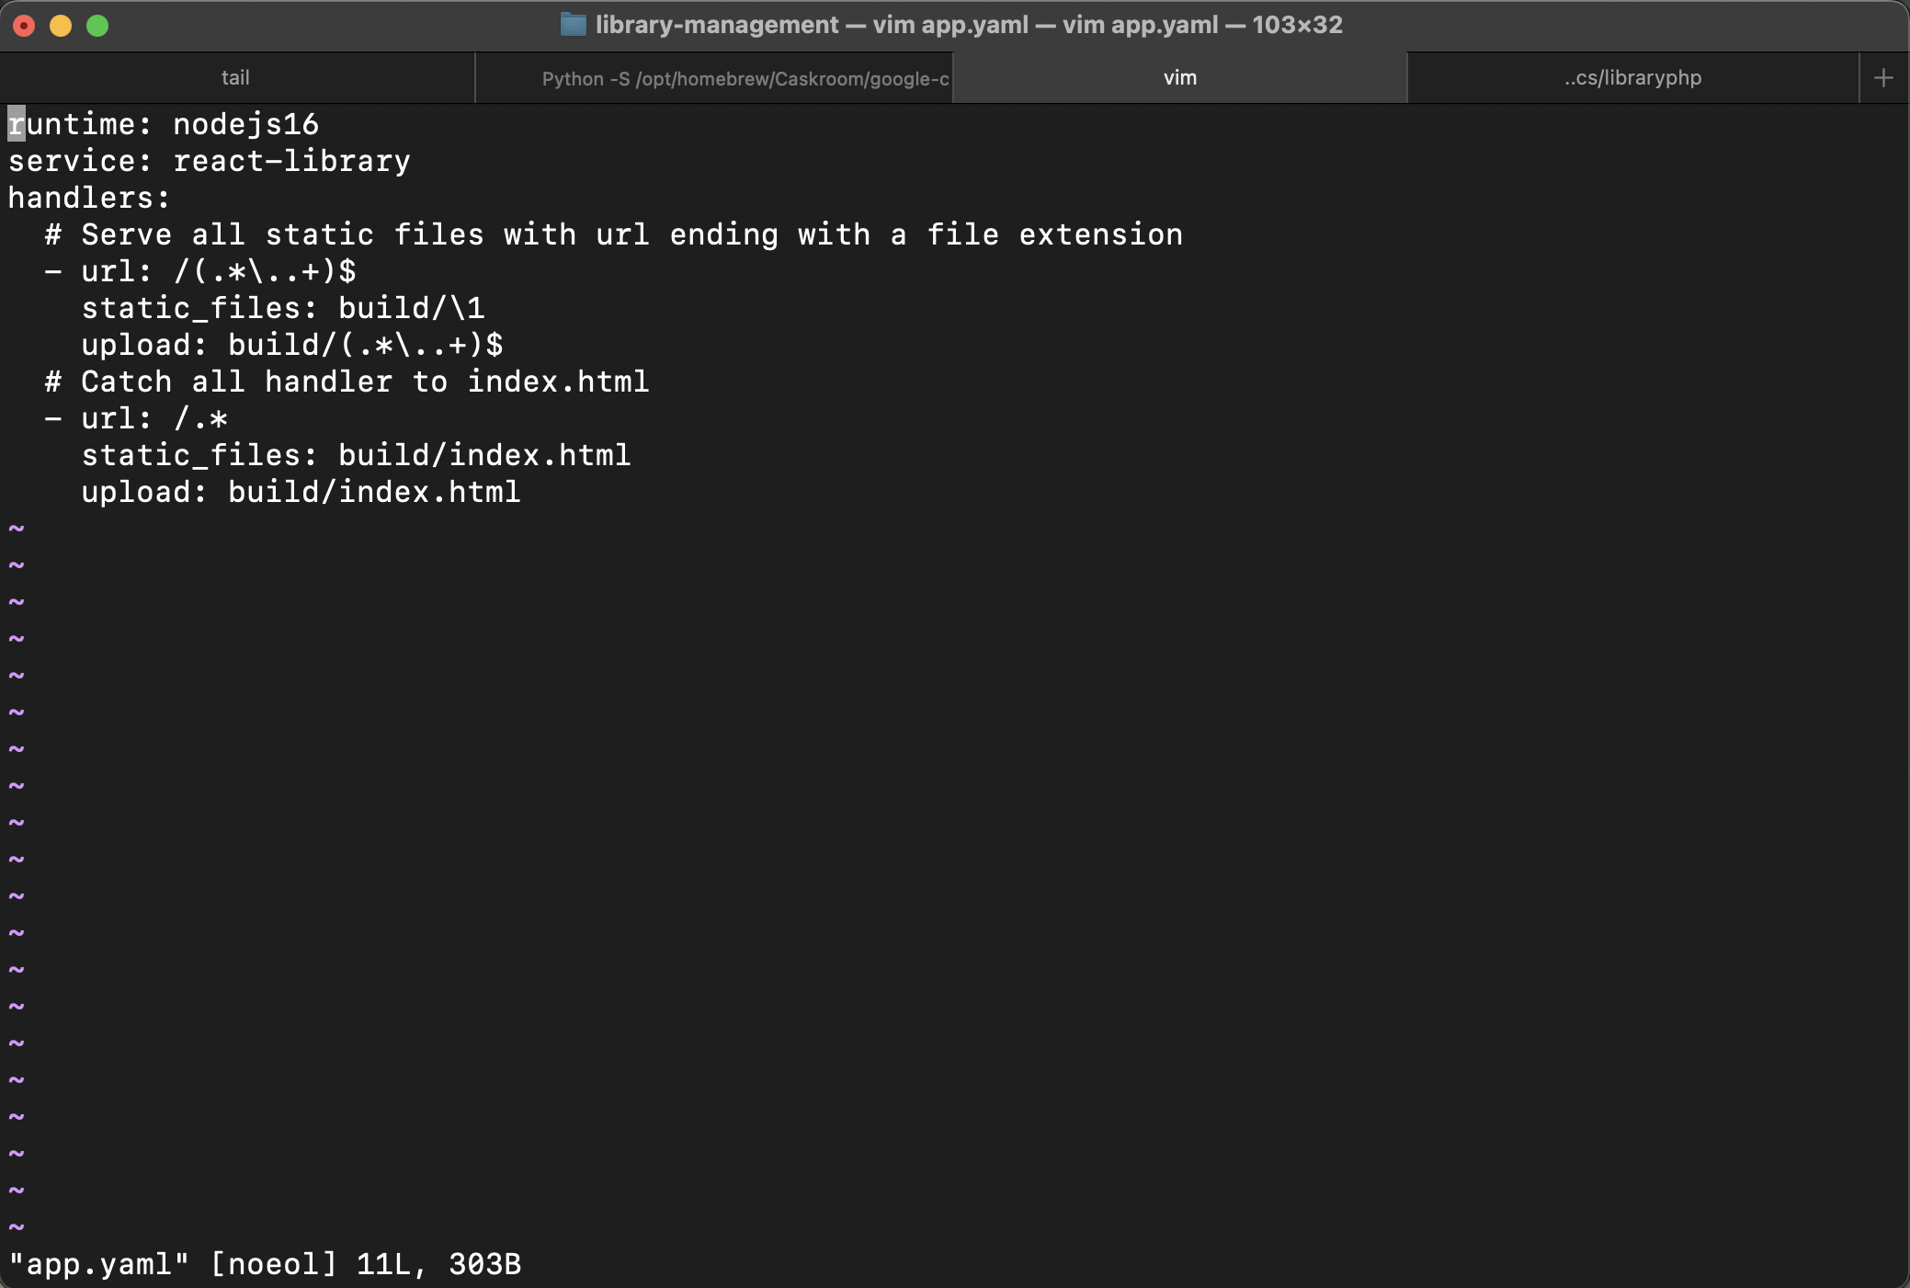
Some screen shots

Slide 6
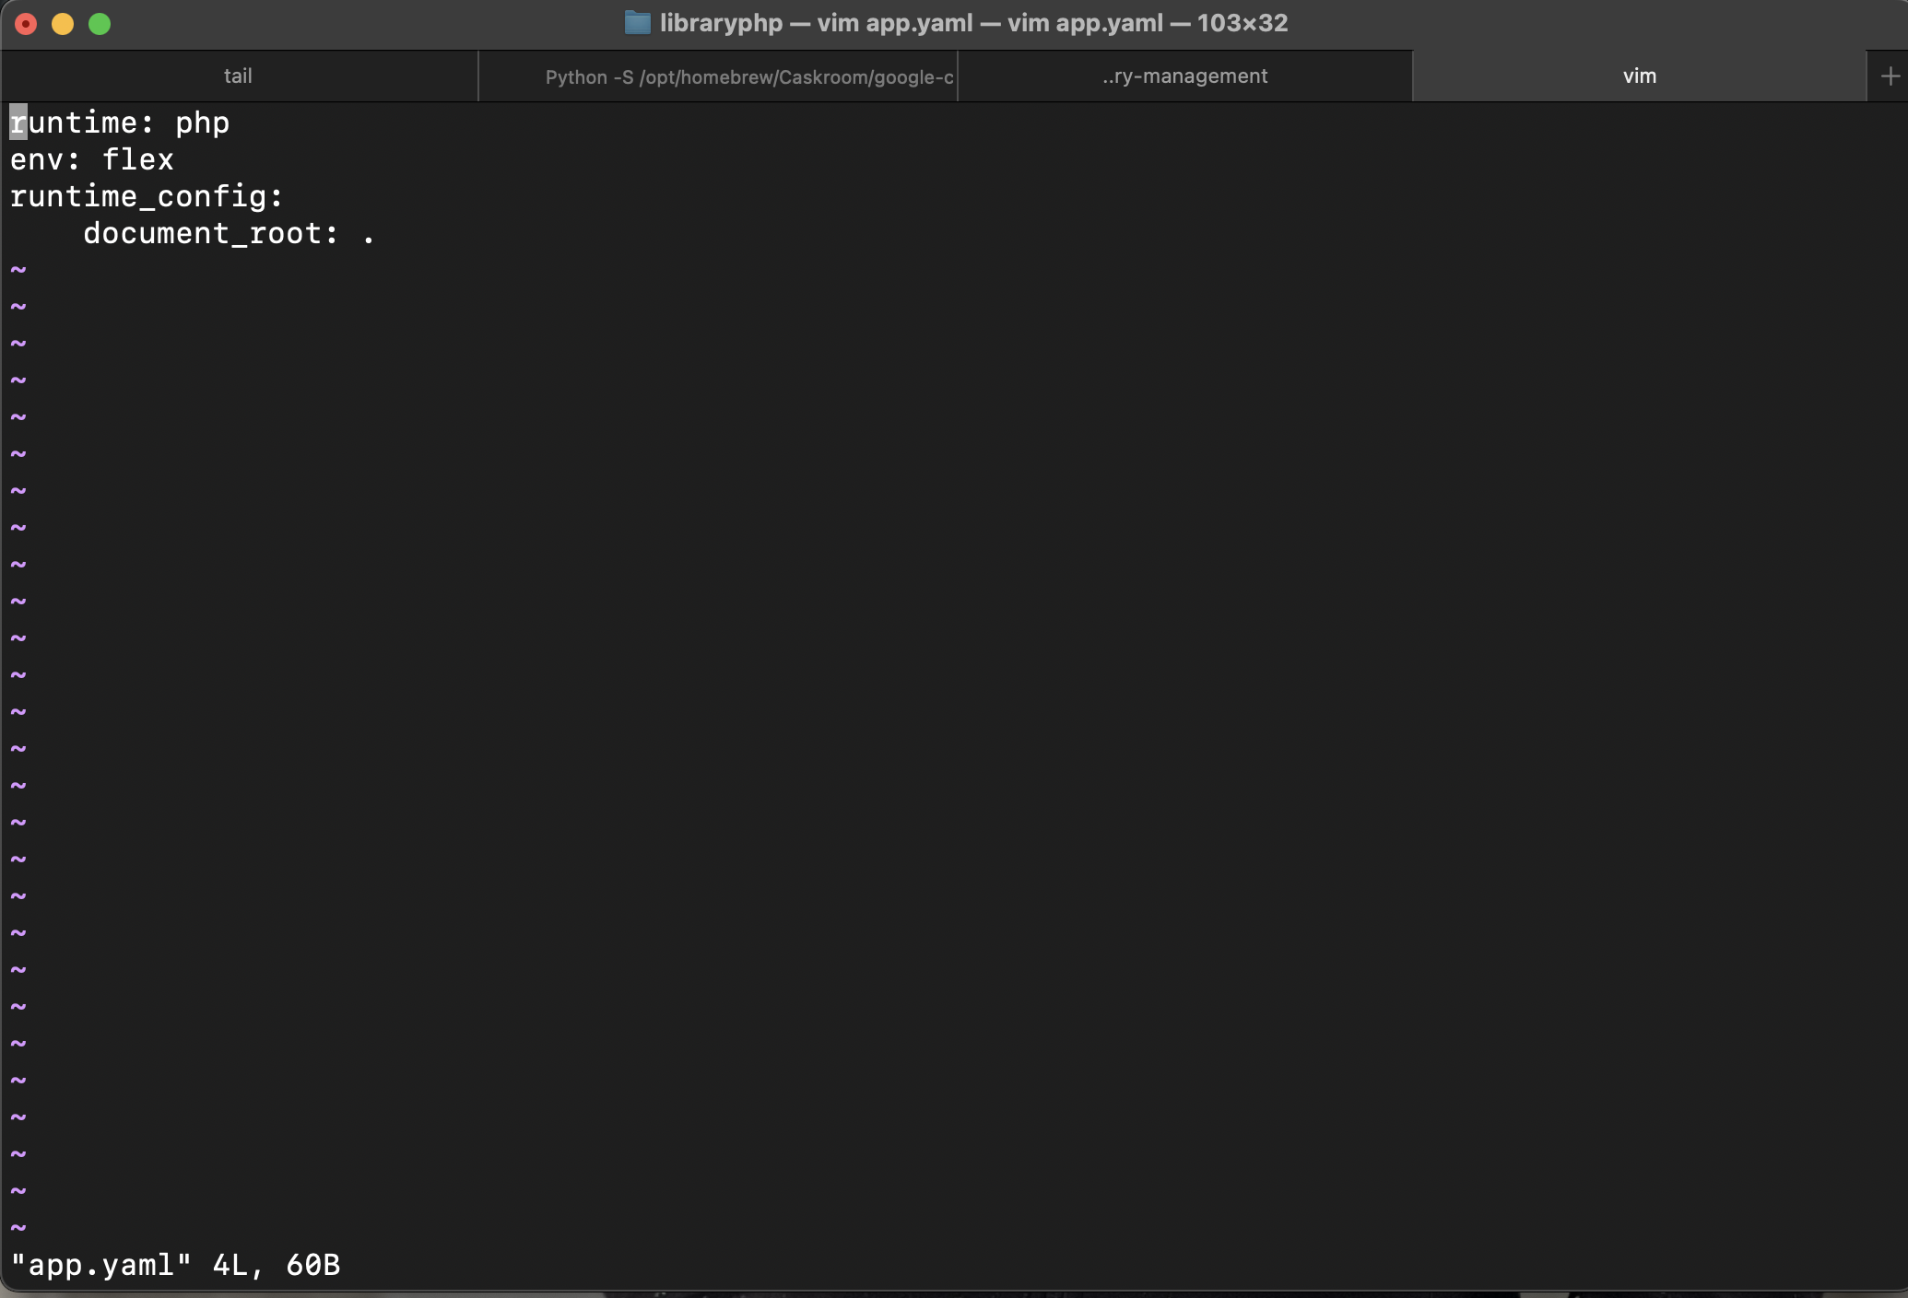

Slide 7
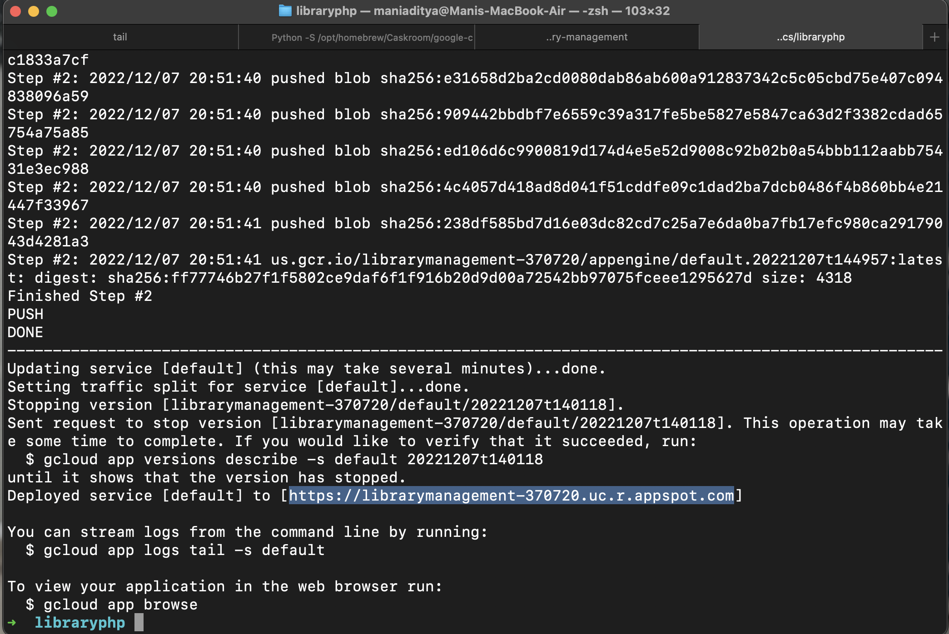

Slide 8
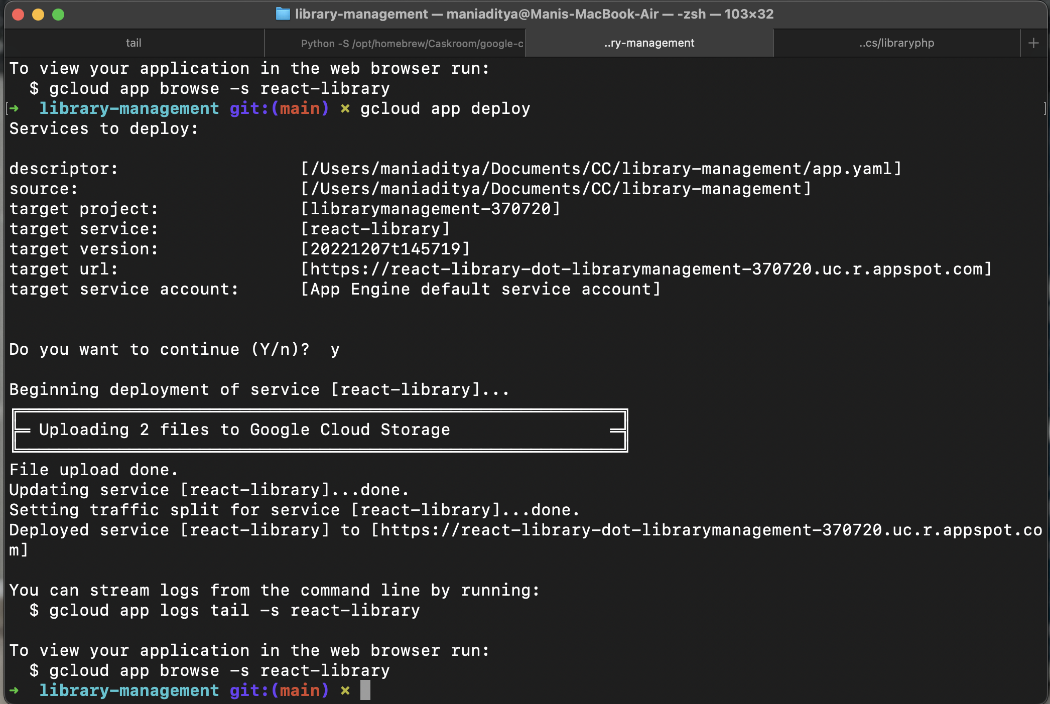

Slide 9
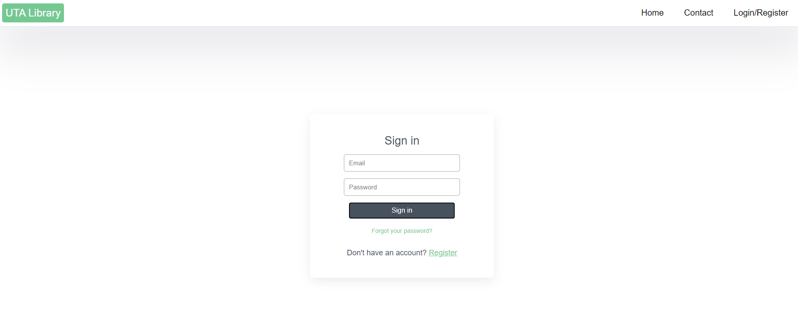

Slide 10
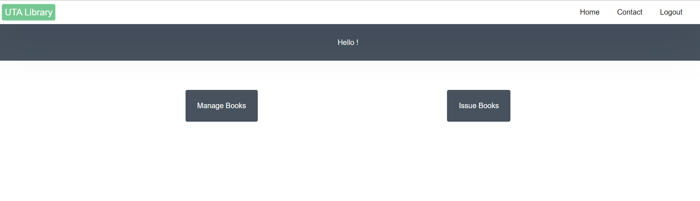
Admin

Slide 11
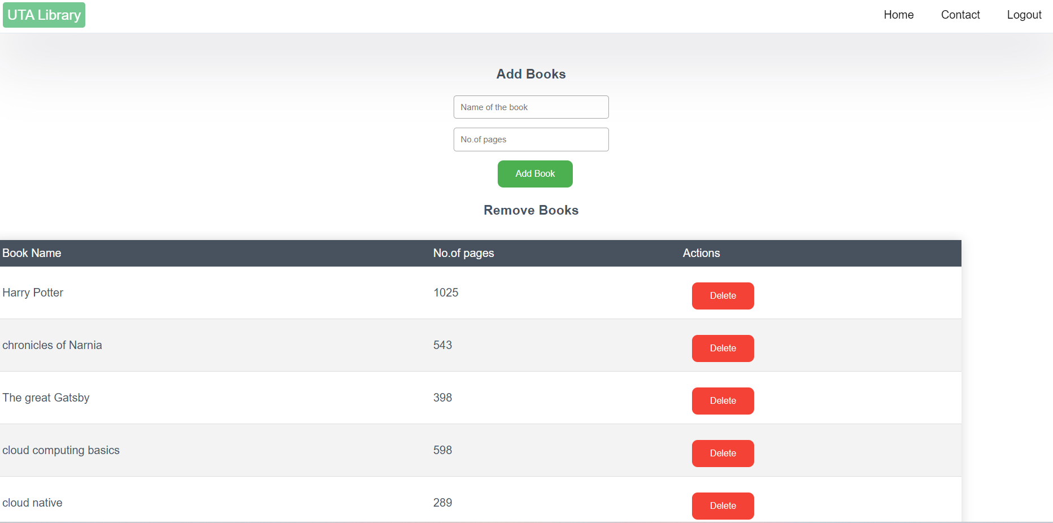

Slide 12
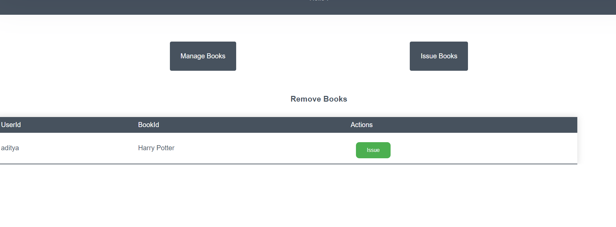

Slide 13
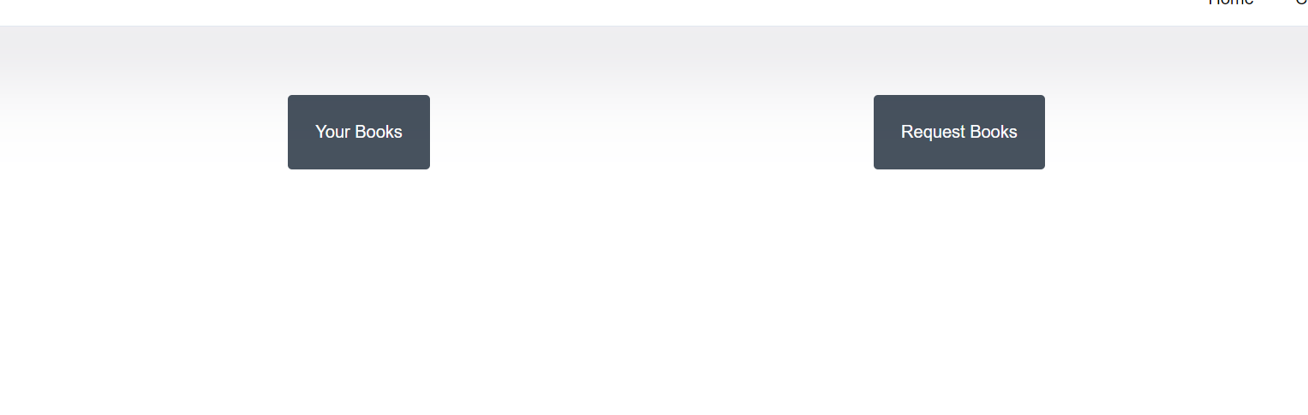
User Login

Slide 14
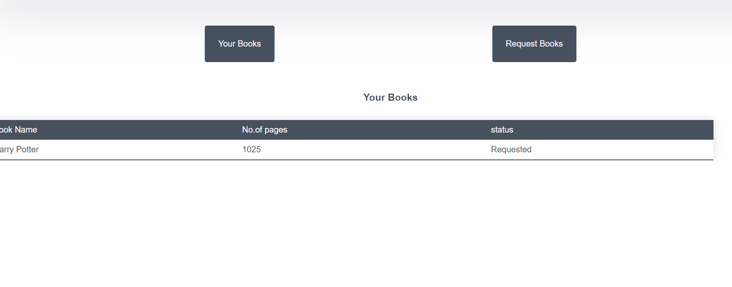

Slide 15
Future Scope
We want to predict when the book would be available making space for more availability of the service provided.

Slide 16
DEMO
https://react-library-dot-librarymanagement-370720.uc.r.appspot.com

